Slide 1


Does Your Business Have the Right Legal Entity?
A Simple Guide to Choosing the Right Structure and Staying Compliant
corporateservices.dbohra.com

Slide 2










WHAT IS A LEGAL ENTITY?
A legal entity is the official structure under which a business is registered, defining its ownership, liability, taxation, and legal responsibilities.
Sole Proprietorship
Partnership
A business owned and controlled by one individual, with no separate legal identity from the owner.
A business structure where two or more individuals jointly own and manage the business under a legal agreement.
01
02
Limited Liability Partnership (LLP)
Private Limited Company
A separate legal entity combining partnership flexibility with limited liability protection for partners.
A separate legal entity owned by shareholders and managed by directors, offering limited liability protection.
03
04
corporateservices.dbohra.com

Slide 3






WHY ENTITY CHOICE MATTERS
Choosing the right business entity determines your legal protection, tax liability, and compliance responsibilities.
It directly impacts your business growth, credibility, ability to raise funds, and long-term sustainability.
03
Tax treatment
02
Impacts how the business income is taxed and the overall tax liability of the owner or entity.
04
Compliance burden
Growth and continuity
Determines the level of legal filings, documentation, and regulatory responsibilities required.
Defines the business’s ability to scale, raise investment, and continue beyond the owner’s involvement.
01
05
Personal asset protection
Business credibility
Protects the owner’s personal assets from business debts, liabilities, and legal risks.
Enhances trust and credibility with customers, banks, investors, and government authorities.
corporateservices.dbohra.com

Slide 4








Corporate Services
Start—ups Formation
Registrations
GST Compliances
Need to set up a Private Limited Company, LLP, or Partnership Firm? We'll handle the details so you can start strong.
From Digital Signatures to FSSAI and MSME, we take care of all your registration needs.
GST
We've got your GST covered—registration, filing, and audits are all managed smoothly.
Virtual Accounting
Legal Services
ROC Compliances
Need to set up a Private Limited Company, LLP, or Partnership Firm? We'll handle the details so you can start strong.
Whether you need Sale Deeds, Trust Registration, or Wills, we provide reliable legal support for your business.
Keep your company or LLP compliant with ease, We manage all your annual ROC filings.
Income Tax
Intellectual Property Rights (IPR)
FEMA Regulations
Navigating income tax can be tricky. Let us handle your filings, TDS and audits with expertise.
We'll make sure you're covered under FEMA regulations so your international transactions go smoothly.
Protect your ideas and brand with our Trademark, Copyright, and Patent services.
corporateservices.dbohra.com

Slide 5


SOLE
PROPRIETORSHIP
(THE SOLO PATH)
Ideal For
Key Requirement
Home-based businesses, freelancers, small shop owners, and entrepreneurs testing new business ideas.
No formal registration is mandatory, but local licenses such as Shop Act and Udyam Registration may be required.
A business owned and controlled by one individual, with no separate legal identity from the owner.
Advantages
Disadvantages
  Full Control
  Easy Setup
  Privacy
  Unlimited Liability
  Limited Growth
Learn More
corporateservices.dbohra.com

Slide 6









Scenario
Zahra, a homemaker, started selling traditional Bohra masalas to neighbors and Jamaat members from her home.
Case Study
Challenge
She wanted a simple and low-cost business structure with minimal legal and compliance requirements.
Zahra’s Home-Based Masala Business (Mumbai)
Solution (Business Structure)
Tax Implication
Income is taxed under individual slab rates (0%–30%), making it highly tax-efficient for small businesses with lower annual profits (e.g., below ₹12 lakhs).
She operated as a Sole Proprietor and obtained the required FSSAI license to ensure legal compliance.
Financial Approach
The business was self-funded, with profits reinvested into operations and no dependence on external loans.
Key Steps:
Outcome
She retained full control and profits, benefited from lower tax liability, and efficiently managed orders through WhatsApp.
corporateservices.dbohra.com

Slide 7

PARTNERSHIP FIRM
(THE TEAM PATH)
Ideal For
Key Requirement
Businesses with two or more owners such as family businesses, professional services, trading firms, and small-to-medium enterprises.
A Partnership Deed defining roles, profit sharing, and responsibilities; registration is optional but recommended for legal protection.
A business structure where two or more individuals jointly own and manage the business under a legal agreement.
Advantages
Disadvantages
  Shared Responsibility
  Easy to Start
  Combined Skills & Capital
  Flexible Operations
  Unlimited Liability
  Risk of Disputes
  Limited Growth Potential
  Lack of Continuity
Learn More
corporateservices.dbohra.com

Slide 8
Scenario
Two sisters started a boutique together, where one managed design and production, and the other handled sales and customer relationships.
Case Study
Areeba & Mariyamrida Boutique (Pune)
Challenge
They needed a clear profit-sharing arrangement and defined responsibilities without the complexity of forming a company.
Tax Implication
Partnership firms are taxed at a flat rate of 30% on profits, while the share of profit received by partners is tax-exempt in their personal income. Additionally, salary and remuneration paid to partners can be claimed as expenses, reducing the firm’s taxable profit.
Solution (Business Structure)
They formed a Partnership Firm with a legally drafted Partnership Deed specifying equal profit sharing (50–50) and mutually agreed financial terms.
Key Steps:
Outcome
The defined structure ensured clarity in roles, minimized conflicts, and enabled smooth business operations with shared responsibility and liability.
corporateservices.dbohra.com

Slide 9

Limited Liability Partnership
Ideal For
Key Requirement
Professional services (CAs, consultants, architects), family-run businesses, and growing businesses needing liability protection with operational flexibility.
Minimum two partners, LLP registration with MCA, LLP Agreement defining roles and profit sharing, and annual compliance filings.
A business structure where two or more individuals jointly own and manage the business under a legal agreement.
Advantages
Disadvantages
  Limited Liability
  Separate Legal Entity
  Perpetual Succession
  Lower Compliance than Pvt Ltd
  Better Credibility
  Mandatory Compliance
  Penalty for Non-Compliance
  Limited Fundraising Options
  Public Disclosure
Learn More
corporateservices.dbohra.com

Slide 10
Scenario
Three brothers operated a furniture manufacturing workshop handling large and high-value client orders.
Case Study
Challenge
Hakimi Modular Solutions LLP (Indore)
They faced significant financial risk from potential client defaults and wanted to protect their personal assets, including their homes.
Tax Implication
LLPs are taxed at a flat rate of 30% on profits, and profit distribution to partners is tax-free in their personal hands, making withdrawals tax-efficient. Audit is required only if annual turnover exceeds ₹40 lakhs or capital contribution exceeds ₹25 lakhs.
Solution (Business Structure)
They converted their business into an LLP, ensuring that each partner’s liability was limited to their capital contribution.
Key Steps:
Outcome
The business was funded through partner capital, with disciplined financial policies to avoid interest-based borrowing and overdrafts.
corporateservices.dbohra.com

Slide 11

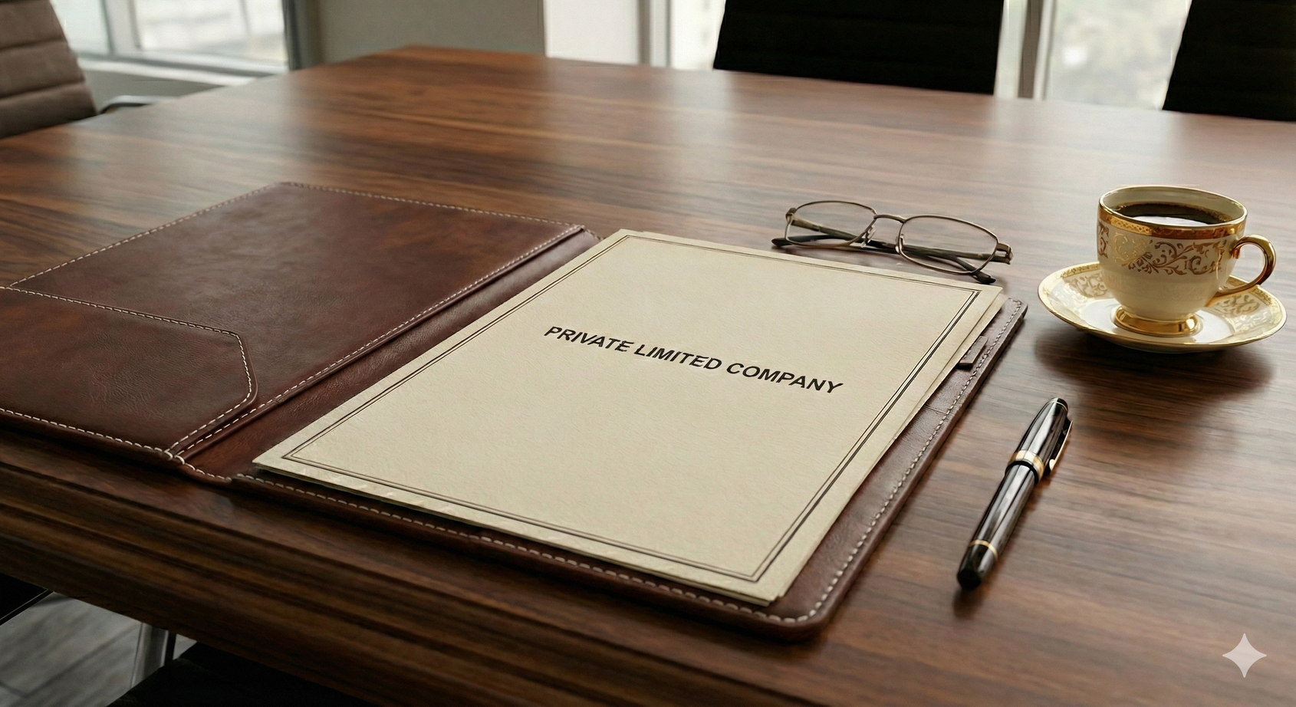
Private Limited Company (The Scalable Path)
Ideal For
Key Requirement
Startups, high-growth businesses, manufacturing units, exporters, and businesses planning to raise investment or scale nationally or internationally.
Minimum two directors and one shareholder, registration with MCA, DIN and DSC for directors, ROC incorporation, and ongoing compliance such as annual filings and audits.
A business structure where two or more individuals jointly own and manage the business under a legal agreement.
Advantages
Disadvantages
  Limited Liability
  Separate Legal Entity
  Perpetual Succession
  Better Credibility
  Mandatory Compliance
  Higher Setup and Maintenance Cost
  Reduced Operational Flexibility
  Public Disclosure

Slide 12
Scenario
A family-run health food business aimed to expand its presence by supplying products to large supermarkets and retail chains.
Case Study
Challenge
Burhani Foods Pvt Ltd (Surat)
Distributors and retail chains preferred dealing with a registered corporate entity, and the family needed a structured succession plan for future generations.
Tax Implication
Private Limited Companies are taxed at corporate tax rates (approximately 25%, or 15% for eligible new manufacturing companies). Dividend distributed to shareholders is taxable in their personal hands, while directors can draw salaries as a tax-efficient method of income withdrawal.
Solution (Business Structure)
They incorporated a Private Limited Company with family members as shareholders and directors.
Outcome
Key Steps:
The company gained credibility with large retailers, successfully entered organized retail chains, and established a clear and secure succession pathway for the next generation.
corporateservices.dbohra.com

Slide 13



01
Operating Informally Without Legal Registration
Running a business without proper registration limits legal protection, credibility, and future growth opportunities.
Common Legal Mistakes
02
Absence of Written Legal Agreements
Not having formal agreements creates ambiguity in roles, responsibilities, and dispute resolution.
Starting without proper registration, written agreements, licenses, financial separation, or the right business structure can lead to legal disputes, penalties, tax issues, and hinder business growth.
03
No Separation Between Personal and Business Finances
Mixing finances increases personal liability risks and creates complications in accounting and taxation.
04
Ignoring Mandatory Licenses and Regulatory Requirements
Failure to obtain required licenses and registrations can result in penalties, legal action, and business disruption.
corporateservices.dbohra.com

Slide 14

Partnership vs LLP
Compare partnership operations with LLP for better understanding
01
Simple and Flexible
Separate Legal Entity
01
Easy to start and operate with minimal legal formalities and flexible management between partners.
The LLP is legally independent from its partners and can own assets, enter contracts, and operate in its own name.
02
Unlimited Liability
Limited Liability
02
Partners are personally responsible for all business debts, putting their personal assets at risk.
Partners’ personal assets are protected, and their liability is limited only to their capital contribution.
03
Minimal Compliance
Moderate Compliance
Partnership firms have fewer legal filing requirements and are not required to file annual returns with MCA, but must comply with tax filings and applicable licenses.
Requires basic annual filings and documentation with government authorities, but fewer formalities than a company.
03
corporateservices.dbohra.com

Slide 15
Corporate Services Offered
Start—ups Formation
Legal Services
Need to set up a Private Limited Company, LLP, or Partnership Firm? We'll handle the details so you can start strong.
Whether you need Sale Deeds, Trust Registration, or Wills, we provide reliable legal support for your business.
Registrations
ROC Compliances
From Digital Signatures to FSSAI and MSME, we take care of all your registration needs.
Keep your company or LLP compliant with ease, We manage all your annual ROC filings.
GST Compliances
Income Tax
We've got your GST covered—registration, filing,
and audits are all managed smoothly.
Navigating income tax can be tricky. Let us handle your filings, TDS and audits with expertise.
Virtual Accounting
FEMA Regulations
Our virtual accounting services offer accurate bookkeeping and personalized financial support to fit your business.
Protect your ideas and brand with our Trademark, Copyright, and Patent services.
corporateservices.dbohra.com

Slide 16

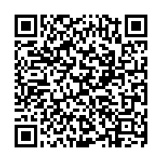


Take the First Step Towards Legal Compliance with
Register with us to receive expert guidance on business registration, compliance, and legal protection tailored to your business needs.
Scan to
Register Now!
corporateservices.dbohra.com
corporateservices@dbohra.com

Slide 17

Partner with as a Service Provider
Join our network of trusted professionals and grow your practice by serving verified business clients.
Register as a VENDOR!
corporateservices.dbohra.com
corporateservices@dbohra.com

